Slide 1

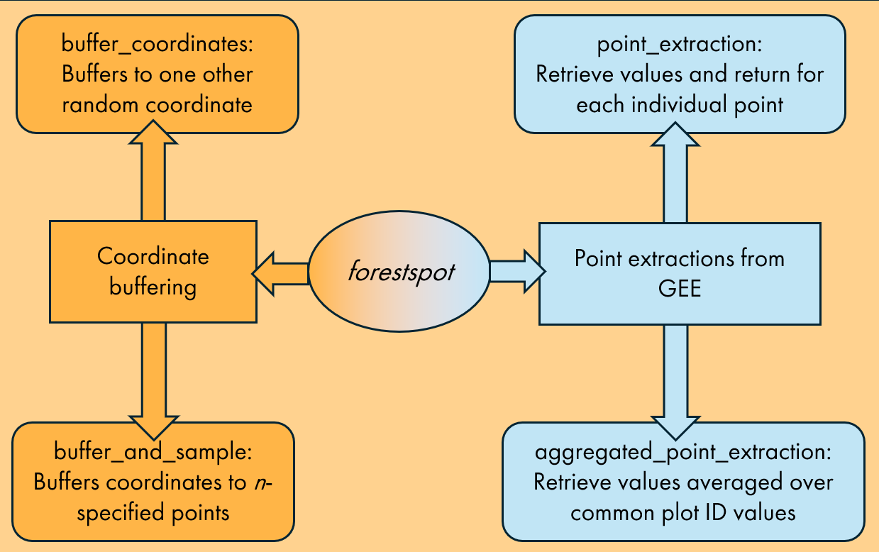

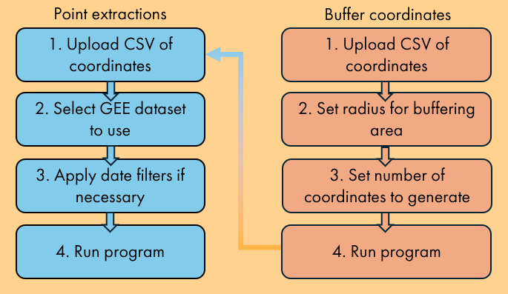

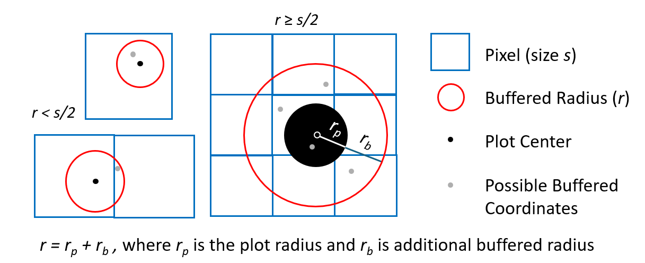





forestspot
Usage
Framework
a geospatial application by foresters for foresters
Two functionality groups:
Point extractions
Performs pixel extractions for provided list of coordinates²
Inputs: coordinates file (dd.) + select GEE dataset
Making point buffering and pixel extractions from Google Earth Engine datasets faster and easier
Buffering approaches
Optional step to buffer sensitive coordinates prior to ‘Point extractions’
Inputs: coordinates file (dd.), radius r, no. coordinates to generate
Tara Skibaª, Tyler Giffordª, Chris Mihiar^{b}, Thomas Brandeis^{c}
Workflow
y
ª University of Tennessee, Knoxville, School of Natural Resources, Forest Biometrics Lab
^{b} CTrees
^{c} U.S.F.S. Forest Inventory and Analysis Southern Research Station
Rationale
x
Installation
Motivation
In a Python session:
Geospatial data can provide information like environmental variables or remotely sensed vegetation indices
But! Accessing and handling geospatial data can be hard!¹
pip install forestspot
Point extraction modules
Buffering considerations
Solution
Buffering modules
lat,
long
Create a point-and-click oriented application to reduce steps
Three steps needed to pull pixel values from Google Earth Engine Images and ImageCollections
How should radius and no. coordinates be chosen?
It depends ☺
No Python? No problem!
Web-based app
Percent Differences (%)
BIO var | Public vs. Private (baseline) | Single Buffer on Private vs. Private | 10-Point Buffer on Private vs. Private
01 | 0.45 | 0.43 | 0.48
02 | 0.18 | 0.19 | 0.21
03 | 0.08 | 0.09 | 0.11
04 | 0.03 | 0.04 | 0.03
05 | 0.21 | 0.21 | 0.23
… | … | … | …
15 | 0.34 | 0.45 | 0.48
16 | -0.14 | -0.14 | -0.14
17 | -0.17 | -0.20 | -0.18
18 | -0.15 | -0.15 | -0.15
19 | -0.14 | -0.17 | -0.15
Case study
Scan to view WorldClim dataset info
Results show that low error exists among all buffering methods compared to raw queried values.
In this case, the public FIA coordinates are sufficient for WorldClim BIO variables.
To demonstrate how forestspot can complement existing inventories, we queried environmental data from WorldClim BIO var V1 using the U.S. Forest Service Forest Inventory and Analysis (FIA) inventory plots located on 10 national parks and forests in southern Appalachia³.
Private FIA plot coordinates’ returned values were compared against public FIA coordinates’, a single private-buffered coordinate’s (r = 1 mi), and 10 private-buffered coordinates’ (r = 1 mi) returned values. (WorldClim resolution: 927.67 m)
Citations
¹Fassnacht FE, White JC, Wulder MA et al. Remote sensing in forestry: current challenges, considerations and directions. Forestry: An International Journal of Forest Research 2024;97(1):11–37. https://doi.org/10.1093/forestry/cpad024.
² Wu Q. geemap: A Python package for interactive mapping with Google Earth Engine. Journal of Open Source Software 2020;5(51):2305. https://doi.org/10.21105/joss.02305.
³ https://developers.google.com/earth-engine/datasets/catalog/WORLDCLIM_V1_BIO
github.com/taraskiba/forestspot
Funding provided by
taraskiba.github.io/forestspot/examples/usage
Funding was provided by USDA Forest Service Agreement # 21-CR-11330145-070.

